Slide 1

Lecture 3
Strategic Market Planning

Slide 2

Planning: Compose the Big Picture
Planning is everything … almost!
Business planning is an ongoing process that guides short- and long-term decisions.
  Helps identify and build on firm strengths
  Improves managerial decision making
  Develops objectives and provides a means of charting progress toward goals

Slide 3
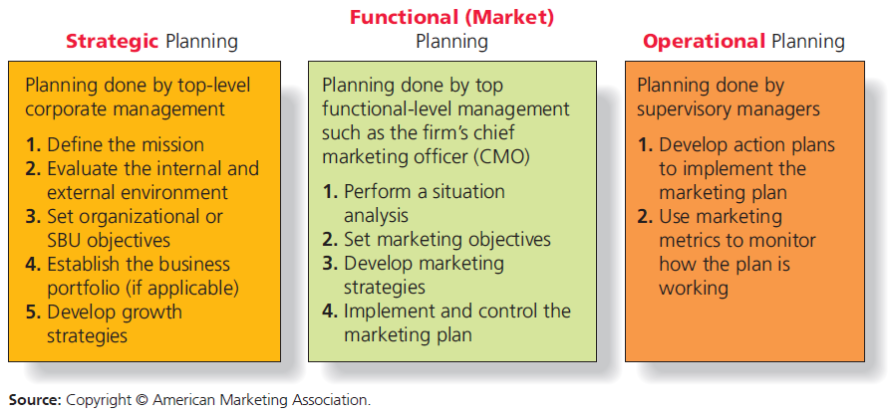
Three Levels of Business Planning
Notes:
Strategic Business Units (SBUs): Large, multiproduct firms may have separate divisions, called strategic business units (SBUs). SBUs operate like a separate business. I.e., Disney SBUs include theme parks, movie studios, TV networks, and cruise line.

Slide 4
Business Planning: An Integrated Activity
Strategic, functional, and operational plans must be in harmony for firm to succeed.
  Planning at all levels flows from organizational mission.
Planners at all levels must keep the “big picture” in mind.
Strategic planning plays an important role in the modern corporation.
  Optimize revenues across multiple lines of business.
  Minimize risk in a complex and changing global environment.
Includes a series of steps that results in development of growth strategies.

Slide 5
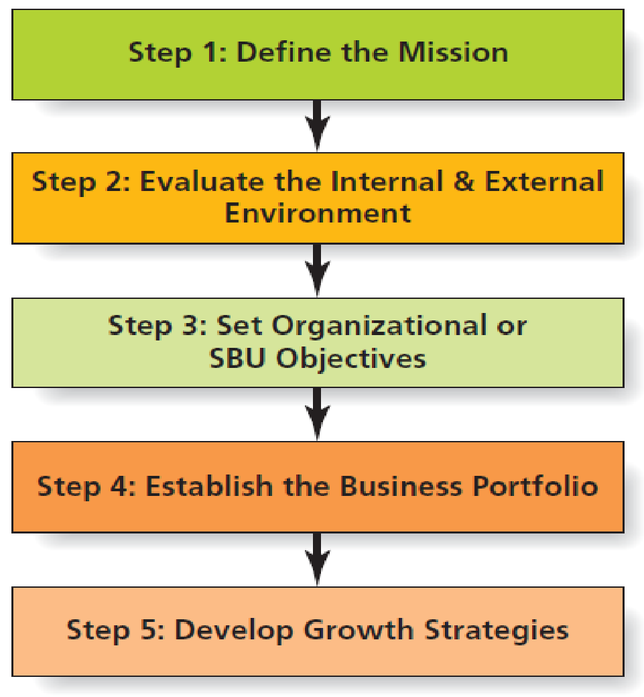
Steps in Strategic Planning

Slide 6

Step 1: Define the Mission
Key questions in determining mission:
  What business are we in?
  What customers should we serve?
  How should we develop the firm’s capabilities and focus its efforts?
A mission statement is a formal document that describes the firm’s overall purpose and what it hopes to achieve in terms of its customers, products, and resources.
Twitter’s mission statement is “To give everyone the power to create and share ideas and information instantly, without barriers.”
The ideal mission statement is not too…
  Broad
  Narrow
  Shortsighted

Slide 7
Step 2: Evaluate the Environment
Examination of internal and external environments
Managers often synthesize environmental analysis into a format known as SWOT analysis.
  SWOT analysis catalogs firms’ internal strengths and weaknesses and external opportunities and threats.
  Internal environment consists of controllable elements within firm.
    Key technologies
    Patents
    Financial stability
    Supplier relationships
    Reputation
    Human capital
External environment consists of factors outside the firm.
  Economy
  Competition
  Technology trends
  Sociocultural trends
  Legal/political/ethical trends

Slide 8
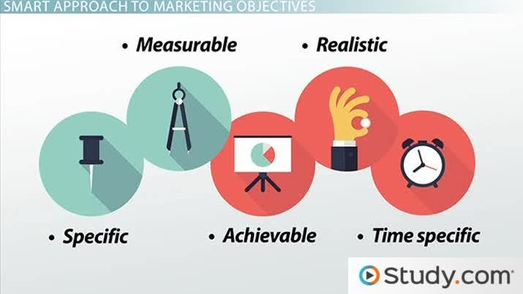
Step 3: Set Organizational or SBU Objectives
Organizational goals and objectives should be direct outgrowth of the mission statement.
  Taking into account internal and external environmental factors
Objectives should be specific, measureable, attainable, and sustainable.
  May be directed toward financial- , operational- , or customer-based criteria

Slide 9
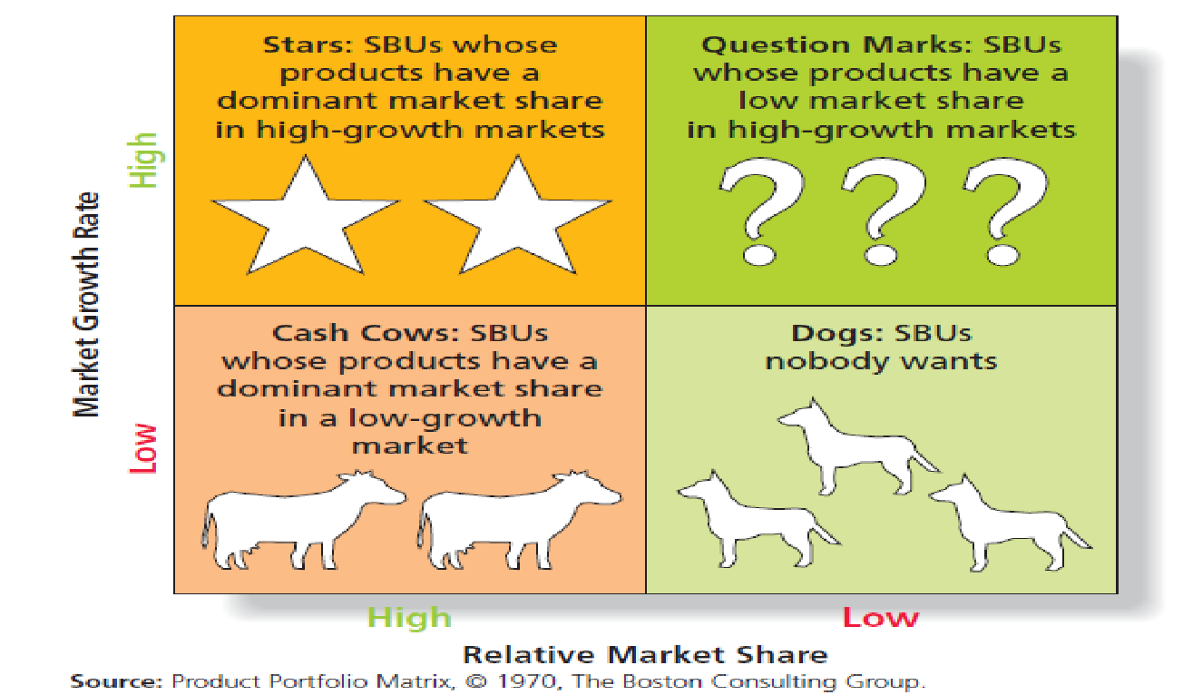
Step 4: Establish Business Portfolio
BCG Matrix
A business portfolio represents the range of different businesses that a large firm operates.
  Disney operates multiple lines of business, including movie studios, theme parks, cruises, etc.
Portfolio analysis: Assesses the growth potential for a firms SBUs and product lines
  BCG Growth-Share Matrix

Slide 10
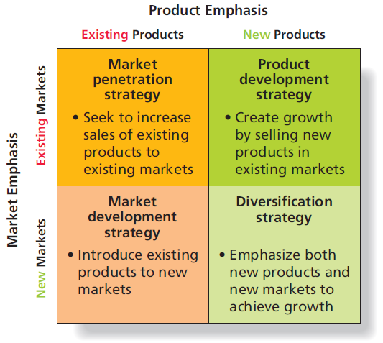
Step 5: Develop Growth Strategies
Product-market growth matrix
Characterizes different types of growth strategies based on market and product types.
Market penetration
Market development
Product development
Diversification
Product–Market Growth Matrix

Slide 11
Self Assessment Exercise
Spend some time to determine the following:
If USC Upstate is a business and each degree it offers is a SBU, Develop the business portfolio for the following degrees:
Biology Business Administration and Economics Chemistry
Psychology Computer Information Systems Criminal Justice
Political Science Engineering Technology Management English
Mathematics Health Information Management History
Sociology Nursing - Bachelor of Science (B.S.N.) Theatre
Art Studio (Graphic Design)

Slide 12
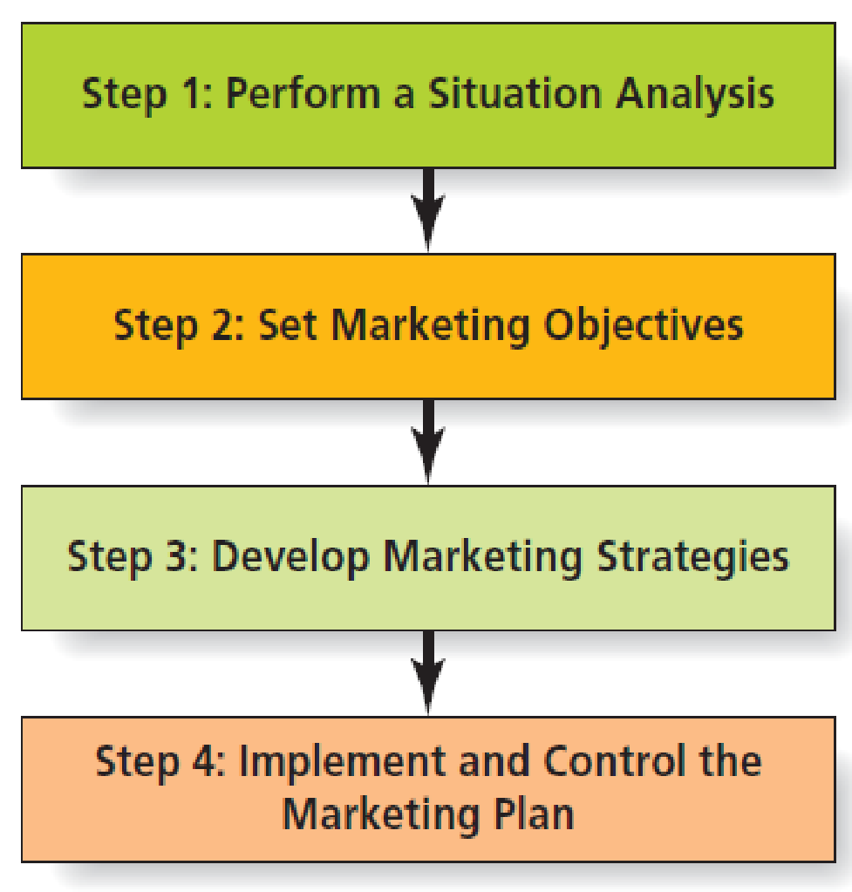
Steps in Market Planning

Slide 13
Action Plans
Assigning Responsibility in the Action Plan
  Not everybody involved will be marketers— Sales, Production, Quality control, Shipping, Customer service, Finance, IT
Creating Action Plan Timelines
  Each action plan requires a time line needed to accomplish the various tasks
  Often portrayed in flowchart form to help visualize sequence of tasks
Setting a Budget— Each cost element of the plan should link to a budget item
  Increases accountability for all parties involved with implementing the marketing plan
  Accuracy in estimating individual action plan expenditures helps budget forecasting.
Measurements and Controls—Marketing control is a formal process for:
  Measuring performance
  Comparing performance to established marketing and strategy objectives
  Making adjustments to the objectives or strategies based on this analysis

